Slide 1

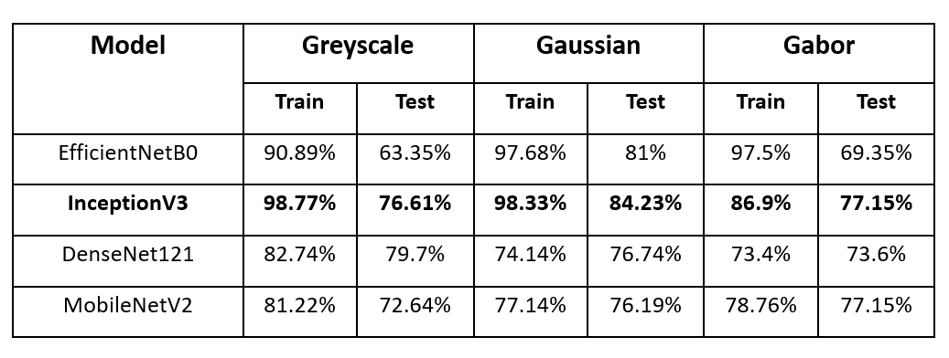
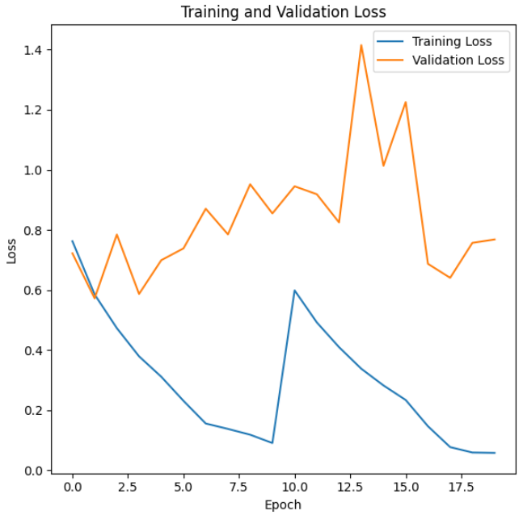
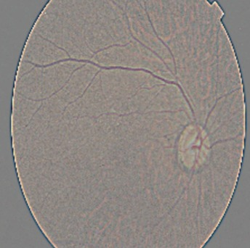
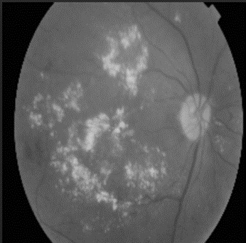
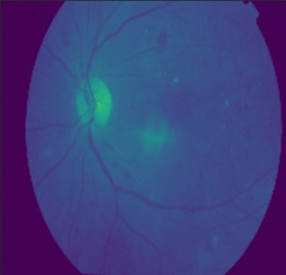
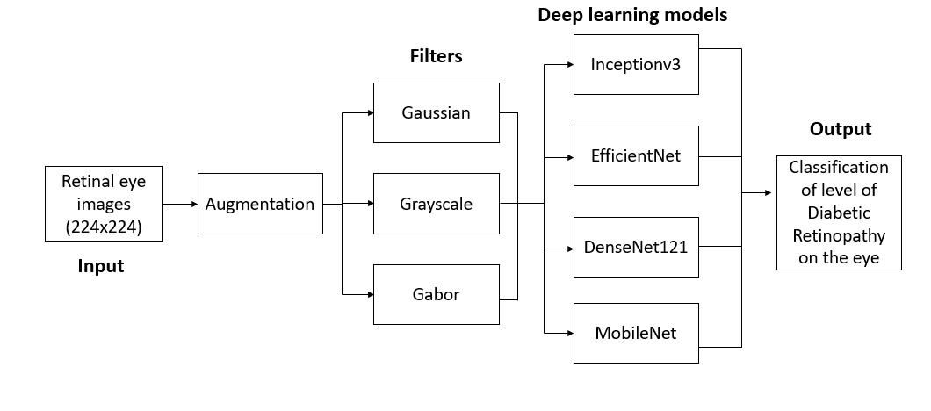
Diabetic Retinopathy using
Gaussian Filter
Roshan Vasu Muddaluru ª , Sharvaani Ravikumar Thoguluva ª, Shruti P ª, Tanuja Konda Reddy ª, Dr.Suja P. ª
ª Department of Computer Science and Engineering, Amrita School of Computing, Bangalore, Amrita Vishwa Vidyapeetham, India
Introduction
Result
Diabetic retinopathy, a common diabetes complication damaging the retina, can cause vision loss. Recent advances in deep learning and convolutional neural networks have enabled automated analysis of retinal images, making DR detection more accurate and efficient. The objective is to develop a methodology for categorizing retinal images that is more effective at discriminating between the five severity classifications of diabetic retinopathy than current automated grading systems.
Both fine and coarse details in retinal images were captured with the use of the manually inserted layers in InceptionV3 that helped extract scales.
Model
The divergence between the training and validation losses indicates overfitting. However, the model is picking up on training data-specific learning patterns that don't translate well to new data.
Gaussian
Grayscale
Gabor
Conclusion
Prior to modelling, two filters were applied to the dataset separately: the Gaussian filter and the Gabor filter along with greyscale which was present in the original dataset.
The four deep learning models InceptionV3, EfficientNet B0, DenseNet121, and MobileNetV2 are fed the pre-processed photos. These models are intended to evaluate the information retrieved by the filters and forecast whether or not diabetic retinopathy will be present in the retinal images, as well as how severe it will be.
The Gaussian filter improved the visibility of the blood vessels and nerves in the pictures which were able to distinguish between the 5 classes.
The Gabor filter, in contrast, emphasized on the contrasting areas that were unable to capture the relevant characteristics.
Future Scope
The model's accuracy for early diabetic retinopathy detection could potentially be improved by applying additional pre-processing techniques like ROI trimming and histogram equalization to enhance blood vessel and nerve visibility in the grey-scaled images.
Alternative neural network architectures such as the vision transformer (VIT) may also outperform conventional models like CNNs on this dataset.
Further experiments with different filters and models are warranted to expand on the work presented in this paper.
References
[1] Wang, Zhiguang, and Jianbo Yang. "Diabetic retinopathy detection via deep convolutional networks for discriminative localization and visual explanation." Workshops at the thirty-second AAAI conference on artificial intelligence. 2018
[2] Keshabparhi, S., and D. D. Koozekanani. "DREAM: Diabetic retinopathy analysis using machine learning." IEEE J. Biomed. Health Informatics 18, no. 5 (2014).
AI for Health and Wellbeing TAG, CSE, ASC, Bangalore

